Slide 1
SEASONAL AGRICULTURE PERFORMANCE ANALYSIS
Major Project – VOIS AICTE Batch 1 2026–2027
Student Name: Pratik Vijay Joshi
College: Progressive Education Society’s Modern College of Arts, Science and Commerce, Ganeshkhind, Pune
AICTE STU ID: STU67e656b99b64b1743148729
VOIS AICTE Batch 1 2026–2027 | Major Project

Slide 2
Problem Statement
Agricultural activities are influenced by seasonal variations in environmental conditions, farming practices, resource availability and market conditions.
Raw agricultural data does not clearly explain how agricultural performance changes across seasons.
This project analyzes the dataset to identify meaningful seasonal patterns, trends, relationships and variations in agricultural performance.
VOIS AICTE Batch 1 2026–2027 | Major Project

Slide 3
Project Description
This project performs a focused Data Analytics and Data Visualization study of agricultural activities across Kharif, Rabi and Zaid seasons.
The dataset includes crop, geographical, environmental, farming, resource and economic information. The analysis covers data cleaning, seasonal comparisons, crop performance, environmental conditions, water efficiency, economic performance, correlation and statistical testing.
The final analysis converts raw agricultural records into visual insights and data-driven recommendations for better seasonal agricultural planning.
VOIS AICTE Batch 1 2026–2027 | Major Project

Slide 4
Who Are the End Users?
• Farmers – compare seasonal crop performance and resource requirements.
• Agricultural departments – support evidence-based seasonal planning.
• Agricultural consultants – understand crop, environmental and resource patterns.
• Agribusinesses – evaluate production and economic performance.
• Researchers and students – study agricultural trends using data analytics.
VOIS AICTE Batch 1 2026–2027 | Major Project

Slide 5
Technology Used
Python
• Pandas – data cleaning and analysis
• NumPy – numerical operations
• Matplotlib – visualization
• Seaborn – statistical visualizations
• SciPy – statistical testing
Development Environment
• Google Colab / Jupyter Notebook
• CSV Dataset
• GitHub for project code and documentation
VOIS AICTE Batch 1 2026–2027 | Major Project

Slide 6
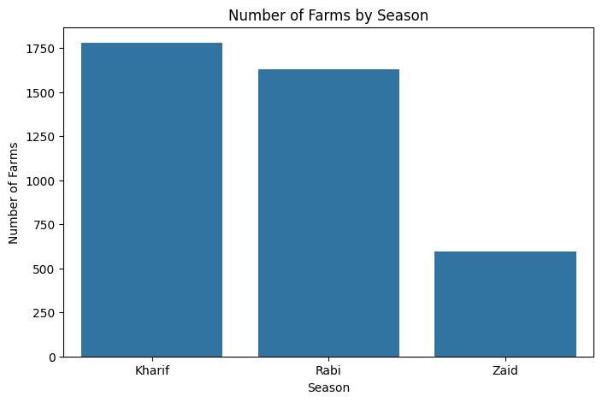
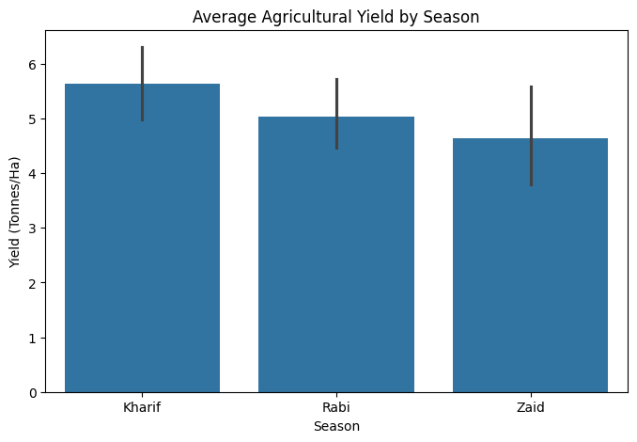
Results – Seasonal Distribution & Yield
Key observation: Kharif has the largest number of farm records and the highest average yield among the three seasons.
VOIS AICTE Batch 1 2026–2027 | Major Project

Slide 7
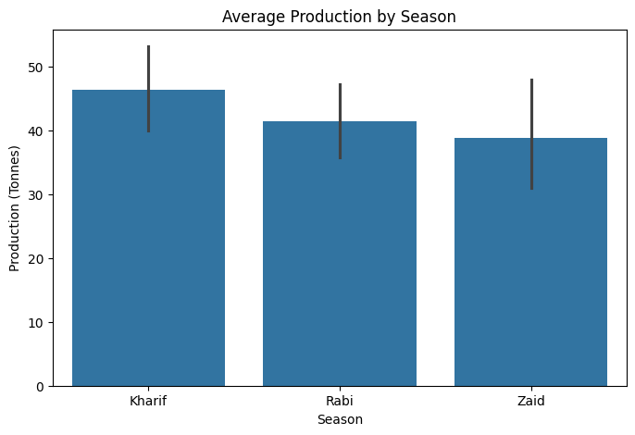
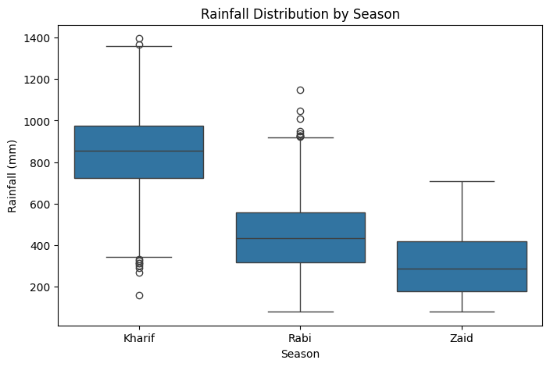
Results – Production & Rainfall
Key observation: Average production and rainfall are highest in Kharif, followed by Rabi and Zaid.
VOIS AICTE Batch 1 2026–2027 | Major Project

Slide 8
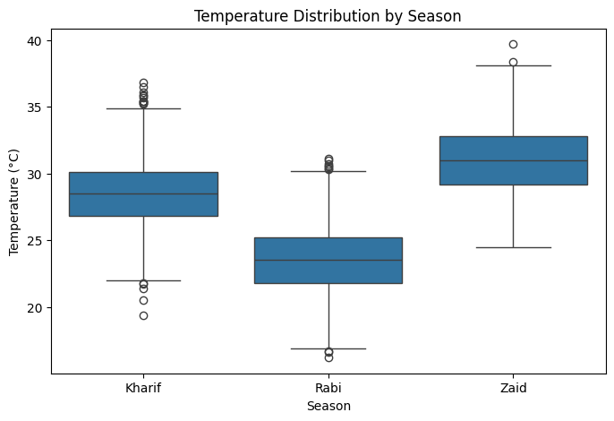
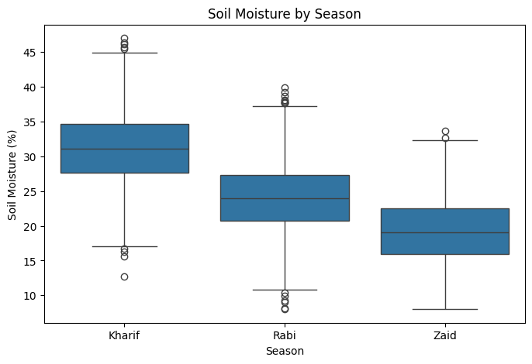
Results – Temperature & Soil Moisture
Key observation: The three seasons show clear differences in temperature and soil-moisture distributions.
VOIS AICTE Batch 1 2026–2027 | Major Project

Slide 9
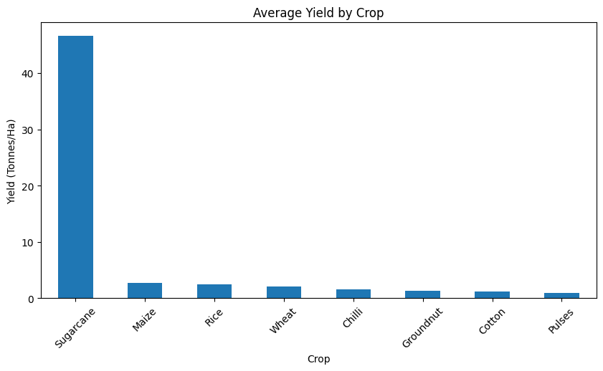
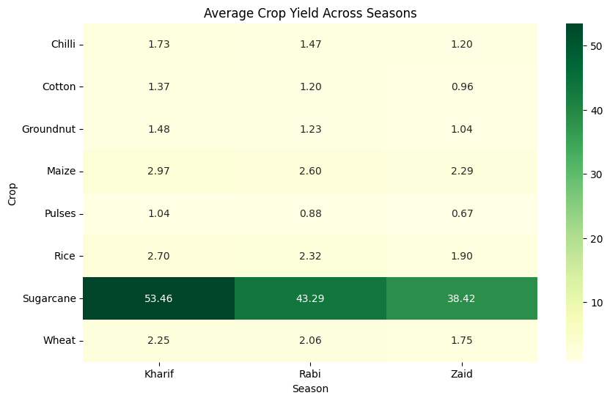
Results – Crop Performance
Key observation: Sugarcane has the highest average yield, with its seasonal yield highest in Kharif.
VOIS AICTE Batch 1 2026–2027 | Major Project

Slide 10
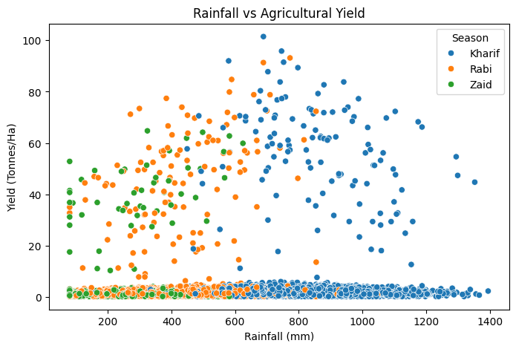
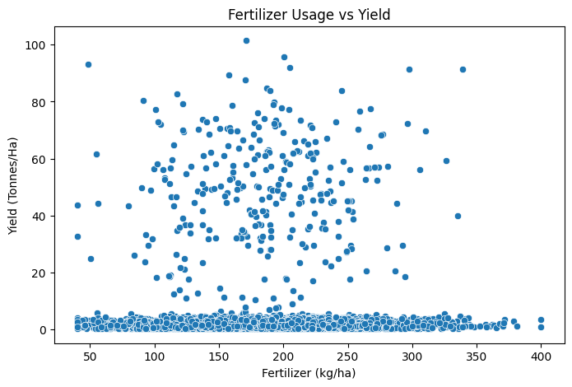
Results – Environmental Relationships
Key observation: Rainfall shows clear seasonal clustering, while fertilizer usage and yield have a dispersed relationship.
VOIS AICTE Batch 1 2026–2027 | Major Project

Slide 11
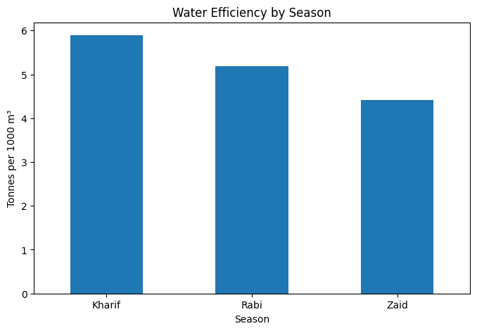
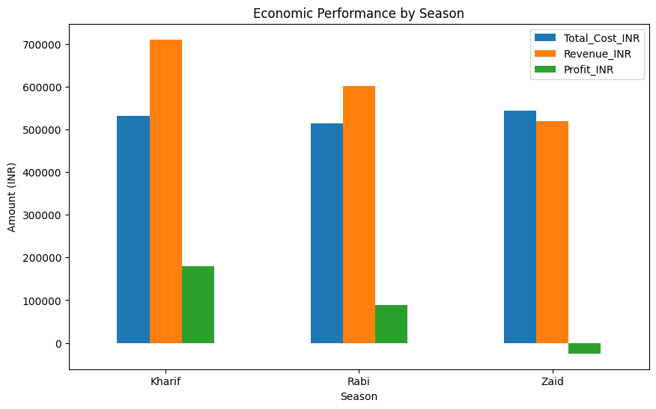
Results – Water & Economic Performance
Key observation: Kharif has the highest water efficiency and strongest economic result; Zaid shows the lowest water efficiency and negative average profit.
VOIS AICTE Batch 1 2026–2027 | Major Project

Slide 12
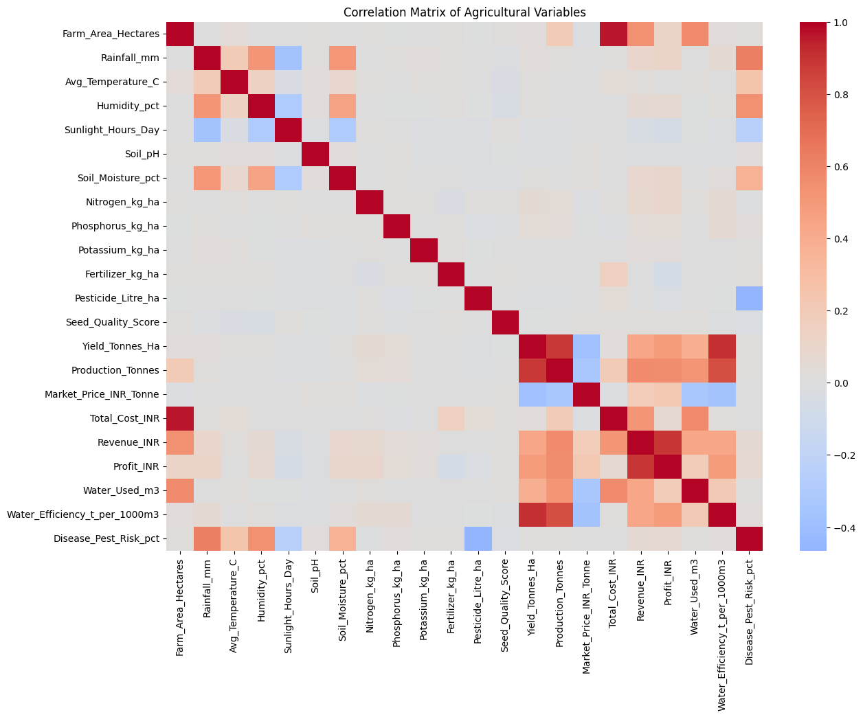
Results – Correlation Analysis
Key observation: Yield shows strong relationships with production and water efficiency, while several economic variables are also related to agricultural performance.
VOIS AICTE Batch 1 2026–2027 | Major Project

Slide 13
Future Scope
• Machine learning models for crop-yield prediction.
• Crop recommendation based on season, soil and environmental conditions.
• Smart irrigation recommendations using water-efficiency analysis.
• Disease and pest risk prediction using historical and real-time data.
• Integration of live weather and market-price data.
• Farmer-friendly mobile or web dashboard.
VOIS AICTE Batch 1 2026–2027 | Major Project

Slide 14
GitHub Link
GitHub URL:https://github.com/pj114667-lab/Seasonal-Agriculture-Performance-Analysis.git
VOIS AICTE Batch 1 2026–2027 | Major Project

Slide 15

VOIS Course Completion Certificate
Course Name: Data Visualization

Slide 16
THANK YOU
VOIS AICTE Batch 1 2026–2027 | Major Project

